Slide 1
Random Forest in Machine Learning
Presented by :
Hrishikesh Deshpande
ADS

Slide 2
What is random forest ?
The Random forest or Random Decision Forest is a supervised Machine learning algorithm used for classification, regression, and other tasks using decision trees.

Slide 3
What happens in classification and regression problem ?
In the case of a classification problem, the final output is taken by using the majority voting classifier.
In the case of a regression problem, the final output is the mean of all the outputs.

Slide 4
What and how uses Random forest ?
A Random Forest is an ensemble technique(Uses bagging method) capable of performing both regression and classification tasks with the use of multiple decision trees.
Random Forest has multiple decision trees as base learning models.
The basic idea behind this is to combine multiple decision trees in determining the final output rather than relying on individual decision trees.

Slide 5
Every decision tree has high variance, but when we combine all of them together in parallel then the resultant variance is low as each decision
tree gets perfectly trained on that particular sample data and hence the output doesn’t depend on one decision tree but multiple decision trees.
A Random Forest is an ensemble technique capable of performing both regression and classification tasks with the use of multiple decision trees and a technique called Bootstrap and Aggregation, commonly known as bagging.

Slide 6
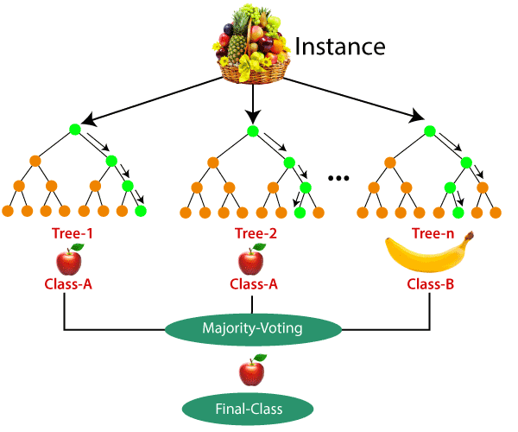
Representation of Random forest :

Slide 7
THANK YOU !!!

